Slide 1
AgrAbility New Staff Training
AgrAbility NTW – March 31, 2014
Lexington, Kentucky
National AgrAbility Project

Slide 2
Session Overview
Overview of National AgrAbility Project (NAP)
History
Structure
Personnel
Goals
Services
Resources

Slide 3
AgrAbility began in 1991 as part of the USDA Cooperative State Research, Education, and Extension Service (“The Extension Service”)
Breaking New Ground started in 1979 and was a model for AgrAbility
In 1991, there were 8 AgrAbility projects; as of 2013, there are 20 state/regional projects covering 22 states plus several affiliate projects

Slide 4
The NAP Structure
All AgrAbility projects – state projects and the national project – are partnerships between the state’s land grant university and at least one rehabilitation-related program.

Slide 5
Current NAP Partners
Breaking New Ground Resource Center, Purdue University (lead organization)
Goodwill of the Finger Lakes (NY)
Arthritis Foundation, Heartland Region
University of Illinois at Urbana-Champaign & Colorado State University (evaluation specialists)

Slide 6
Unfunded Affiliate Programs
Farmer Veteran Coalition
Northwestern University Rehabilitation Engineering Research Center
APRIL (Association of Programs for Rural Independent Living)
RESNA (Rehabilitation and Assistive Technology Society of North America)
RTC Rural at the University of Montana
National FFA Organization
4-H
NAP Structure Chart

Slide 7
Previous NAP Partners
1991 – 2000
Breaking New Ground Resource Center and Easter Seals
2000 – 2008
University of Wisconsin Extension and Easter Seals

Slide 8
The Priority Areas for all AgrAbility Projects
Education
Workshops, conferences, publications
Networking
Partnering with other organizations to fulfill our mission
Assistance
Providing direct services to customers
Marketing
Spreading the word about AgrAbility

Slide 9
Special Responsibilities of the NAP
Provide support to the state and regional AgrAbility Projects
Training
Resources
Consultations with NAP specialists
Provide direct services to customers in states without AgrAbility Projects

Slide 10
What Does AgrAbility Not Provide?
Funding
Equipment (though some Tech Act partners provide certain AT)
Most funding for assistive technology comes through state vocational rehabilitation systems
Other sources of grants and loans are available

Slide 11
NAP Key Personnel
Bill Field, Project Director
Founder of Breaking New Ground
Overall project oversight
Liaison with USDA

Slide 12
NAP Key Personnel
Paul Jones, Project Manager
Management of daily activities
Resource development

Slide 13
NAP Key Personnel
Kylie Hendress, Engagement Coordinator
Public awareness/marketing
Event planning

Slide 14
NAP Key Personnel
Steve Swain, Assistive Technology Specialist
Toolbox process
Liaison with RESNA

Slide 15
NAP Key Personnel
Cliff Racz, Information Technology Specialist
Development of NAP web site and assistive technology database

Slide 16
NAP Key Personnel
Chuck Baldwin, Liaison to 1890 Institutions
Networking with 1890s
Planning workshops with 1890s

Slide 17
NAP Key Personnel
Kate Hamm, Information Training Coordinator
Assistance with technical articles and web-related resources
Social media - Twitter

Slide 18
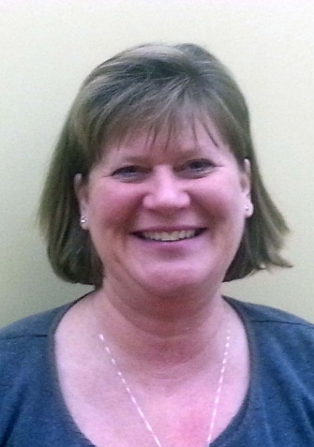
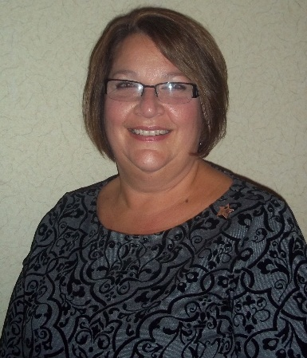
NAP Key Personnel
Goodwill of the Finger Lakes
Promotion of the Goodwill/AgrAbility partnership
Regional workshops
24-hour call center

Slide 19
NAP Key Personnel
Amber Wolfe, Arthritis Foundation AgrAbility Coordinator
Coordinator of AgrAbility’s arthritis-related activities
Workshop in SRAP & non-SRAP states

Slide 20
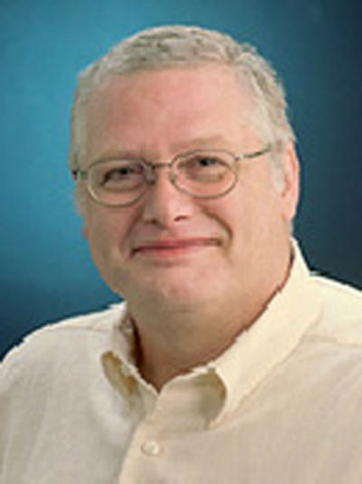
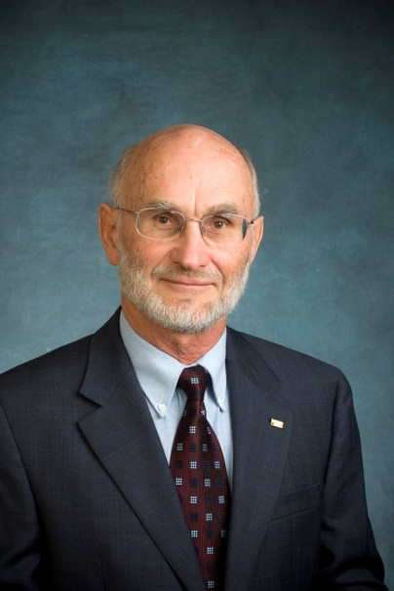
NAP Key Personnel
Evaluation Team
Objective analysis of NAP activities
Annual staff needs assessment
Demographic data
Quality of life evaluation

Slide 21
NAP Resources
Related web sites
www.agrability.org
The Toolbox Assistive Technology Database
www.agrability.org/toolbox
Extranet available for staff
www.agrability.org/Extranet

Slide 22
Other Web Resources
NAP YouTube channel
http://www.youtube.com/user/NationalAgrAbility/
Facebook page
https://www.facebook.com/pages/National-AgrAbility-Project/172045469478427
Twitter feed
https://twitter.com/NatlAgrAbility
www.agrabilityproject.org (former NAP)
www.ruralcare.info (rural caregivers)

Slide 23
The Toolbox
Print, CD, and web versions
www.agrability.org/Toolbox
Approximately 1000 products to help farmers and ranchers with disabilities

Slide 24
Arthritis Resources
www.arthritis-ag.org
Arthritis and Agriculture
Plain Facts about Agriculture
¿Podrá ser la Artritis lo que me causa Dolor? (Could Arthritis be the cause of my Pain?)
Gaining Ground on Arthritis

Slide 25
New Back Health Resource
Back impairments are historically the most prevalent conditions among AgrAbility clients
Covers causes, prevention, management, treatment, etc.

Slide 26
Plowshares
30 technical reports on specific topics, such as farming with a spinal cord injury
Currently being updated

Slide 27
Conducting Agricultural Worksite Assessments
Step-by-step guide for evaluating farms and ranches
Reproducible assessment form
Electronic database for recording data and printing reports

Slide 28
AT Secondary Injury Evaluation
Step-by-step guide for evaluating AT for secondary injury hazards
Reproducible assessment forms

Slide 29
To Everything There is a Season: Rural Caregiver Support
Written resource
Video/DVD
www.ruralcare.info
Includes video clips
Downloadable resources
Links to many organizations

Slide 30
Newsletters
AgrAbility Harvest
Semiannual to national audience
AgrAbility e-Note
Monthly to AgrAbility staff members

Slide 31
Communities of Interest and Standing Committees
Standing Committees
Evaluation
Marketing
National Training Workshop
Networking
Communities of Interest
Arthritis and Agriculture
Assistive Technology

Slide 32
Your Questions

Slide 33
Your Questions
How do Vocational Rehab and Assistive Technology differ in rural areas among those engaged in agriculture and related activities?

Slide 34
Your Questions
What are the typical time frames states expect or experience in meeting, reporting, assisting clients?

Slide 35
Your Questions
Pitfalls with state programs, as well as successes?
Finding clients
Funding AT
Collaborator relationships
Read e-Note for successes

Slide 36
Your Questions
What are the experiences of clients experiencing TBI, learning disabilities, and other cognitive issues in rural areas and agriculture?

Slide 37
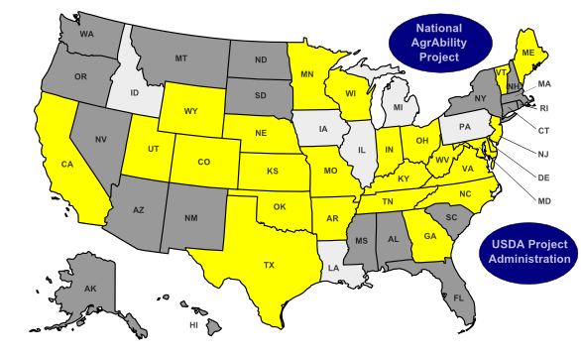
Your Questions
How does AgrAbility serve ethnic and linguistic minorities?

Slide 38
Questions?

